Slide 1

Cloud Native Architecture
Yadhav Jayaraman

Slide 6
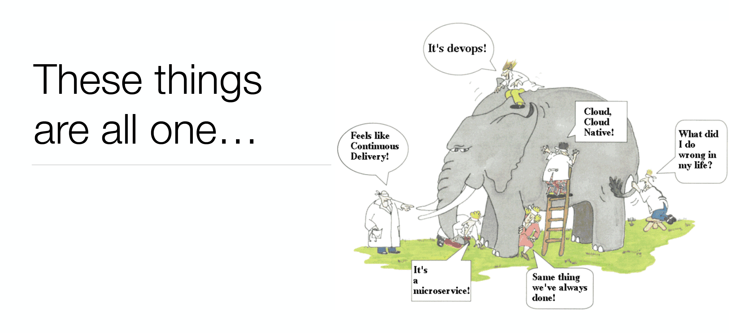

Slide 7
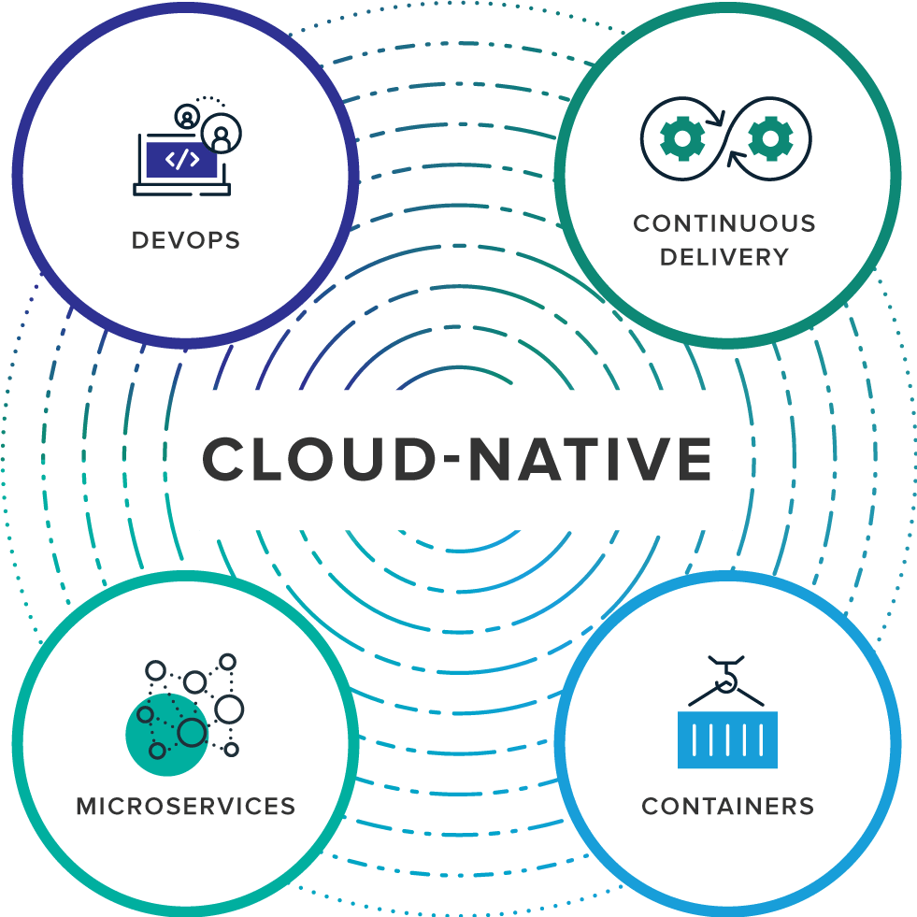
What is Cloud Native?
Notes:
Cloud-native is an approach to building and running applications that fully exploits the advantages of the cloud computing delivery model. Cloud-native is about how applications are created and deployed, not where. While today public cloud impacts the thinking about infrastructure investment for virtually every industry, a cloud-like delivery model isn’t exclusive to public environments. It's appropriate for both public and private clouds. Most important is the ability to offer nearly limitless computing power, on-demand, along with modern data and application services for developers. When companies build and operate applications in a cloud-native fashion, they bring new ideas to market faster and respond sooner to customer demands.
Organizations require a platform for building and operating cloud-native applications and services that automates and integrates the concepts of DevOps, continuous delivery, microservices, and containers:

Slide 8
Key Terms
DevOps is the collaboration between software developers and IT operations with the goal of constantly delivering high-quality software that solves customer challenges. It creates a culture and environment where building, testing and releasing software happens rapidly, frequently, and more consistently.
Continuous Delivery, enabled by Agile product development practices, is all about shipping small batches of software to production constantly, through automation.

Slide 9
Key Terms
Microservices is an architectural approach to developing an application as a collection of small services; each service implements business capabilities, runs in its own process and communicates via HTTP APIs or messaging. Each microservice can be deployed, upgraded, scaled, and restarted independent of other services in the application, typically as part of an automated system, enabling frequent updates to live applications without impacting end customers.
Containers offer both efficiency and speed compared with standard virtual machines (VMs). Using operating system (OS)-level virtualization, a single OS instance is dynamically divided among one or more isolated containers, each with a unique writable file system and resource quota. The low overhead of creating and destroying containers combined with the high packing density in a single VM makes containers an ideal compute vehicle for deploying individual microservices.

Slide 10

Becoming Cloud Native
Notes:
How does one become cloud native and what does it mean ? - lets dig deeper

Slide 11
tl;dr
you are building a software company
or losing to someone who is

Slide 12
tl;dr
you are continuously delivering microservices
or losing to someone who is

Slide 13
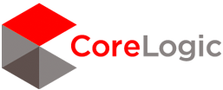


Cloud native and microservice models are moving into the Fortune 500
“I said to my vendors, I don’t want five years ago. I want five years from now.
“Two people built an app and got it into the App Store in five weeks”
“The adopters we speak to today, like GE, HP, Equinix, PayPal, Capital One, Goldman Sachs, Airbnb, Medallia, Square, and Xoom say that microservices are well worth the tradeoffs.”
Notes:
PCF is the 1st and only cloud native vendor at the moment
Source: WSJ http://blogs.wsj.com/cio/2015/10/05/innovate-or-die-the-rise-of-microservices/
Antonio Melo, Humana, CF Summit 2015

Slide 14
Elastic, On-Demand infrastructure

Slide 15
Software developers spend too much time NOT writing software
Design and Coding
Brainstorming
Administrative tasks
Managing Environments
Waiting for Test/Build
Average Hours/Week
Sources: “Electric Cloud LinkedIn Survey to software developers”
Notes:
And here’s the reality.
You have a precious resource that’s spending TOO much of their time, not doing what you hired them to do. And for good reason.

Slide 16
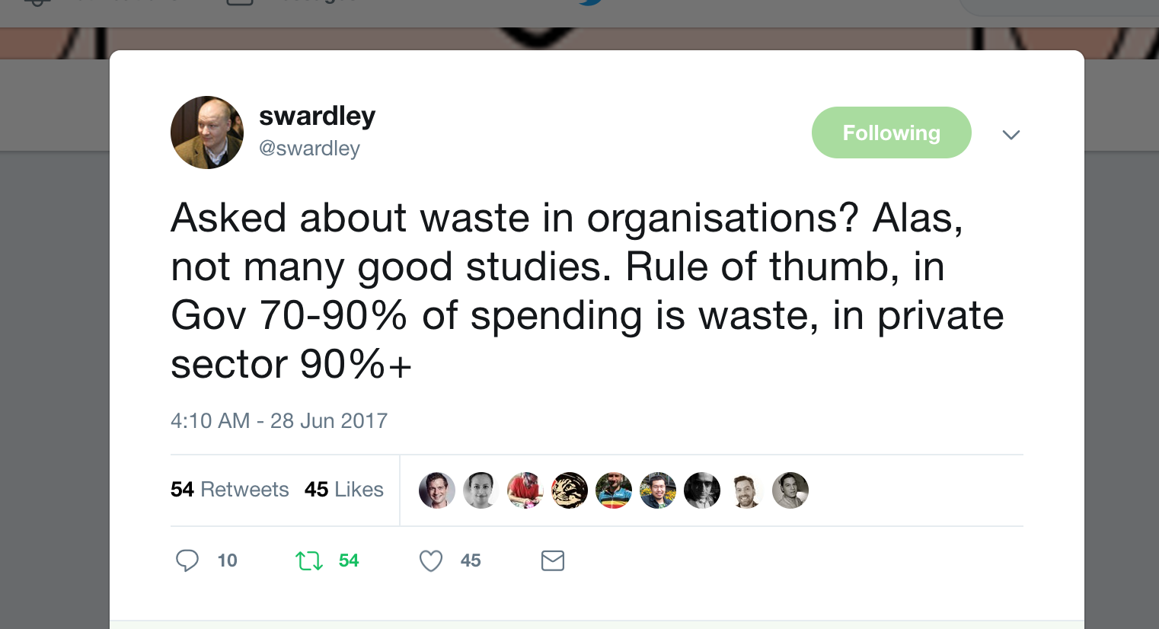
Organizations are notoriously inefficient in delivering value

Slide 17
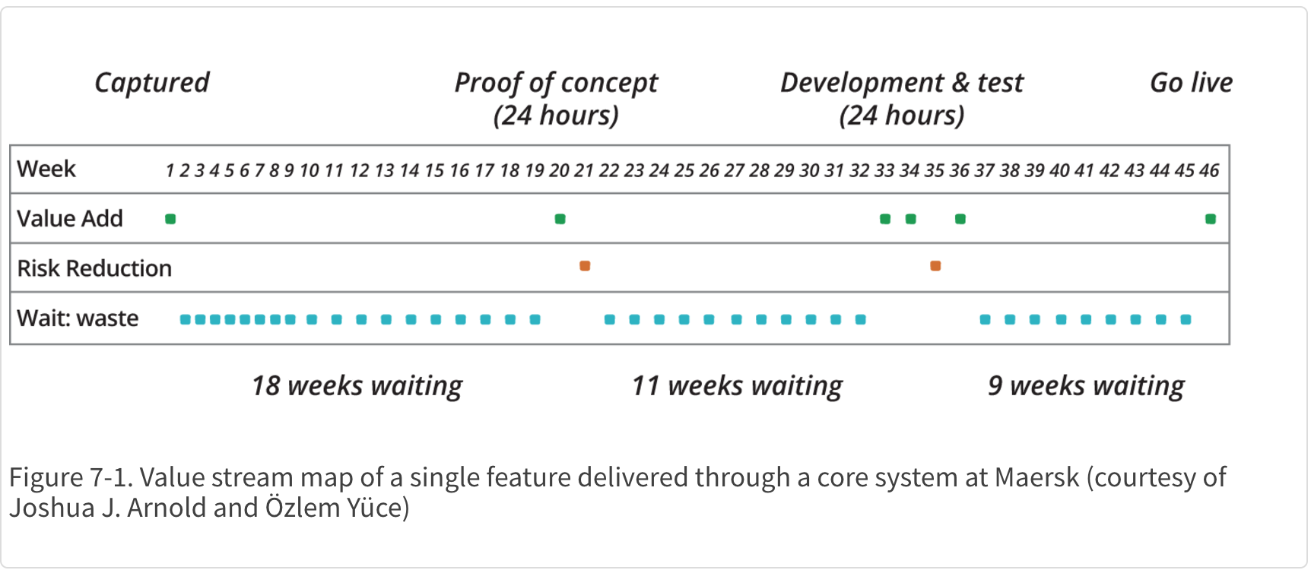
There is a lot of waiting in Enterprise IT processes

Slide 18
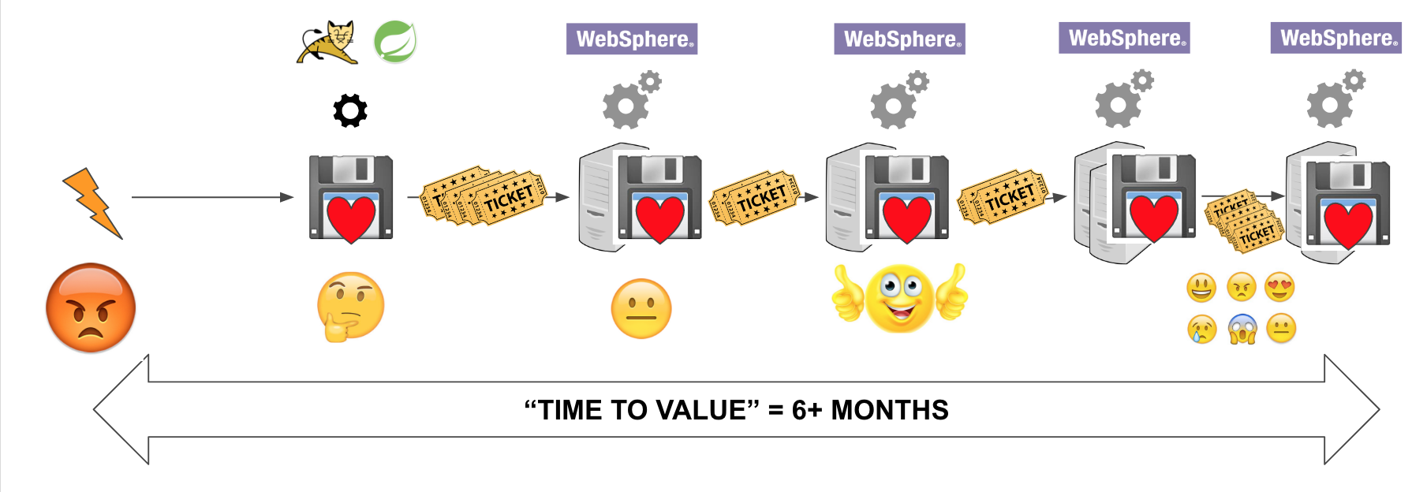
There is a lot of ticketing in Enterprise IT processes

Slide 19
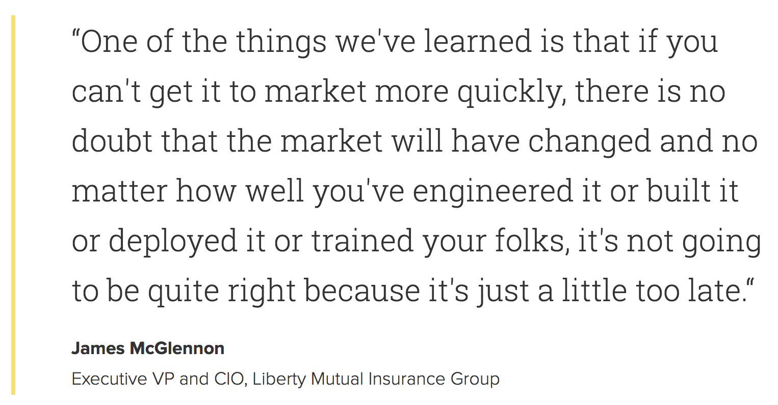
Time is of the essence

Slide 20
Continuous Delivery

Slide 21
A bookstore in Seattle, deploys
code to production every 11 seconds…

Slide 22
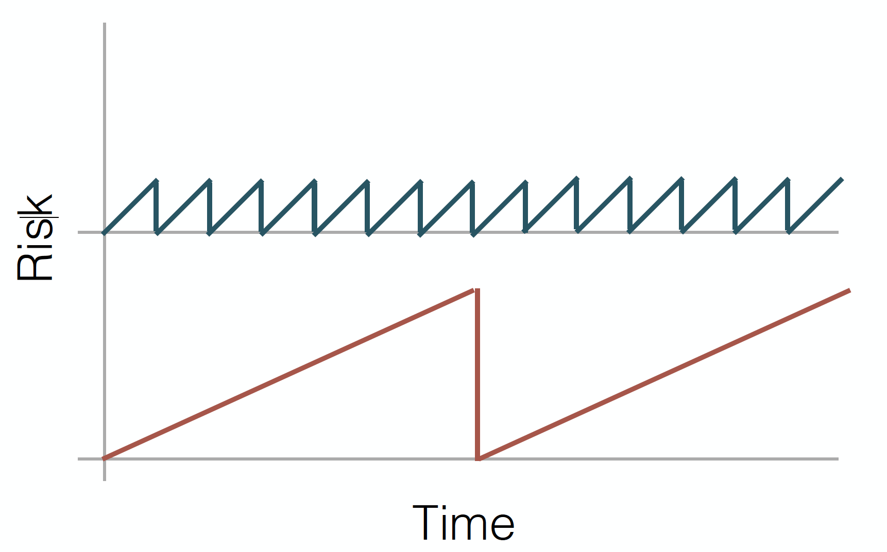

Slide 23
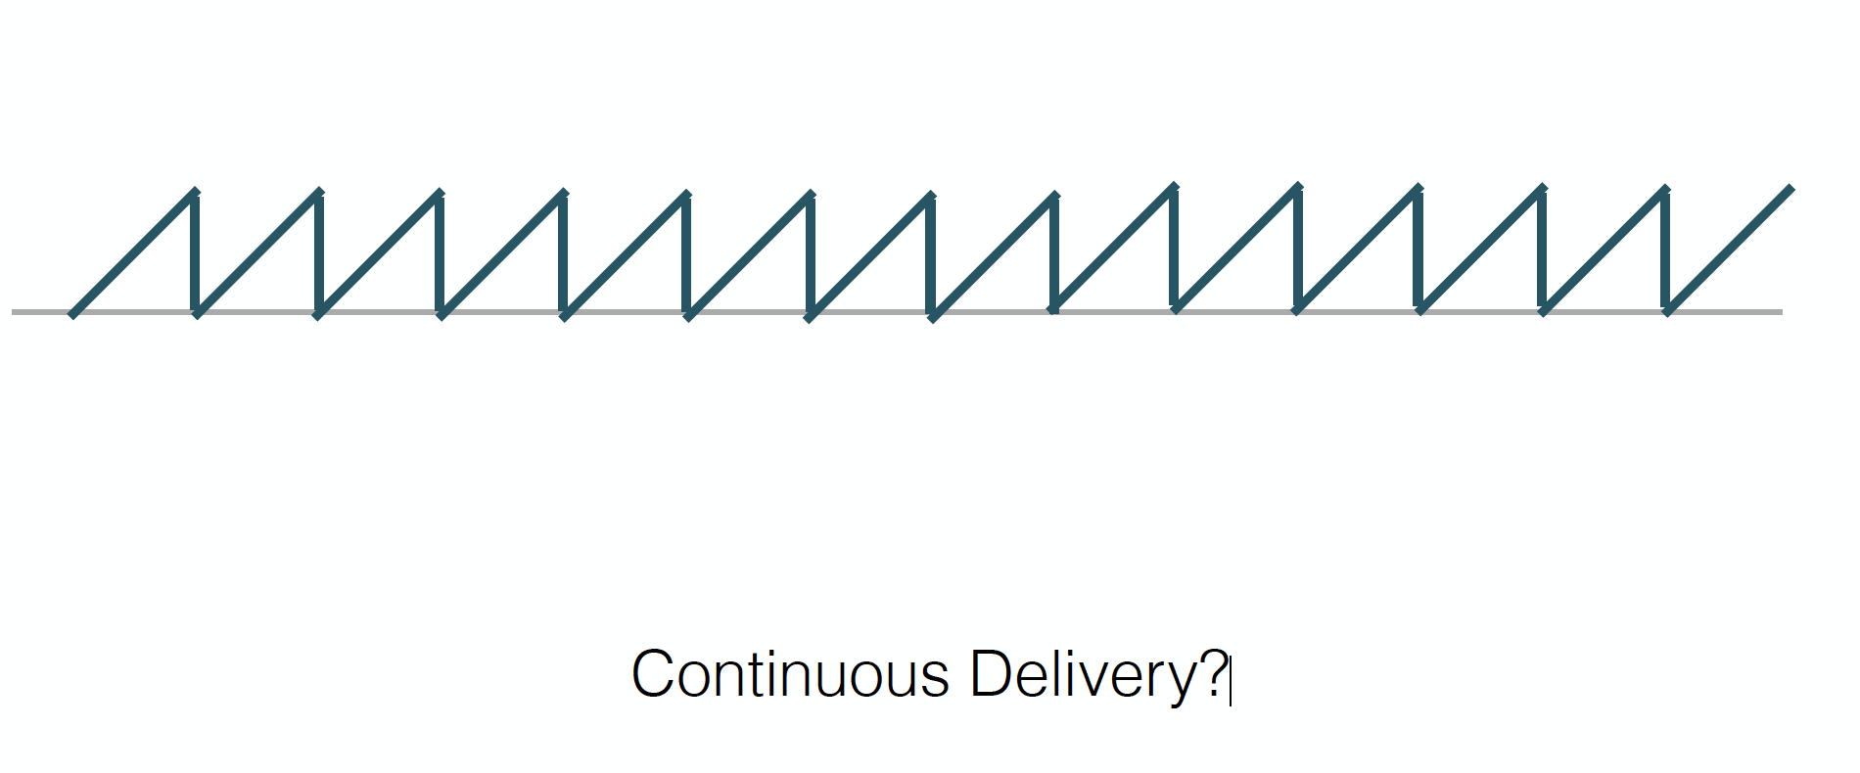

Slide 24


Slide 25
Microservices

Slide 26
The goal of a startup is to figure out the right thing to build— the thing customers want and will pay for— as quickly as possible
- Eric Ries, The Lean Startup

Slide 27
Focus on doing one thing well…
Decouple your code from external depedencies/risks…
That is a micro service

Slide 29
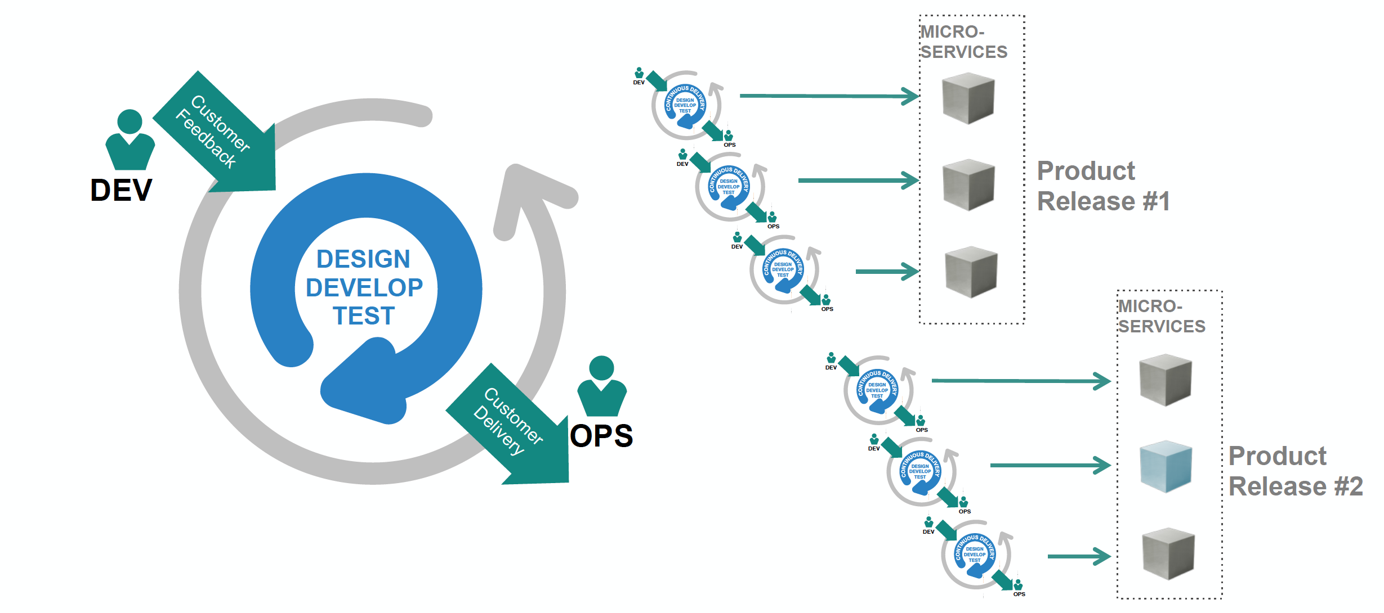
Rise of the cloud natives

Slide 30


Monolithic Architecture: Ripe for Disruption
Many apps start as monoliths
..and get redesigned when
they start to achieve real success
Microservice
(distributed)
User Adoption
Monolithic
Redesign!
Scale of development team / org
http://www.infoq.com/interviews/adrian-cockcroft-microservices-devops
Notes:
Acknowledged as a good way to start
Inefficient / Expensive Scaling
Difficult to optimize single container for multiple applications
$$$ to scale up
Difficult to move to the cloud (in the case of monolithic appserver)
Change Cycles Tightly Coupled / Obstacle to Frequent Deploys
Can Be Intimidating to New Developers
Obstacle to scaling the size of the development team
Any change implies re-testing of the whole monolith, creating barrier
Complex, centralized governance models tend to fail in large organizations
PaaS can run monolithic (12factor) apps as well as uServices

Slide 31




monolith
User
Interface
Like
Photos
Compose Message
Message
Message Notification
Attach a picture
Deployable Unit
Entire team must collaborate into this one unit
Notes:
Whole app is one thing.

Slide 32
microservice
Like
User
Interface
Deployable Unit #2
Deployable Unit #5,6,7
Photos
Compose Message
Deployable Unit #3
Message
Message Notification
Deployable Unit #1
Deployable Unit #4
Attach a picture
Reorg into smaller teams aligned to features
Notes:
Development and DevOps teams can work more independently on microservice style applications, and coupled with the right culture and processes, it fosters a number of desirable traits:
Development Speed, Parallelism in dev efforts
Finer grained operational control – manage / scale just components of the app that require attention
Scalability
Resiliency
Fault tolerance
Graceful degradation
Smaller codebases easier to learn and maintain
Less interdependence makes adding new feature/capability less scary, no need to retest the entire monolith for a given change

Slide 33
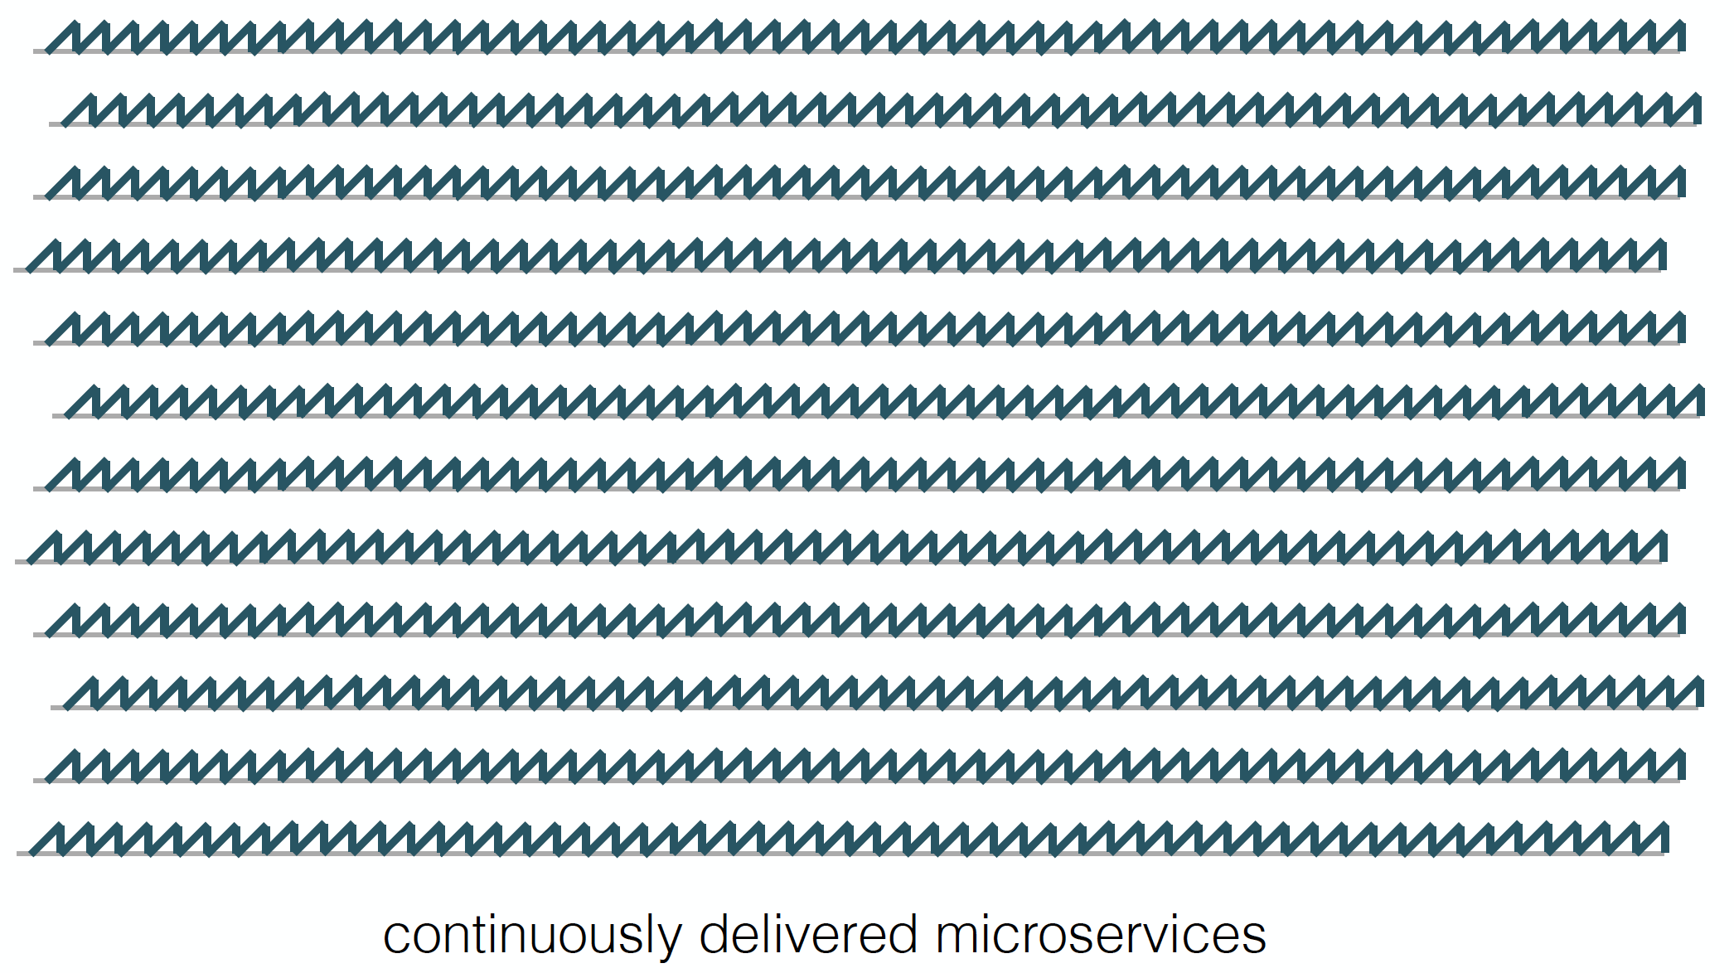

Slide 34
Continously deployed microservices means more things to manage

Slide 35
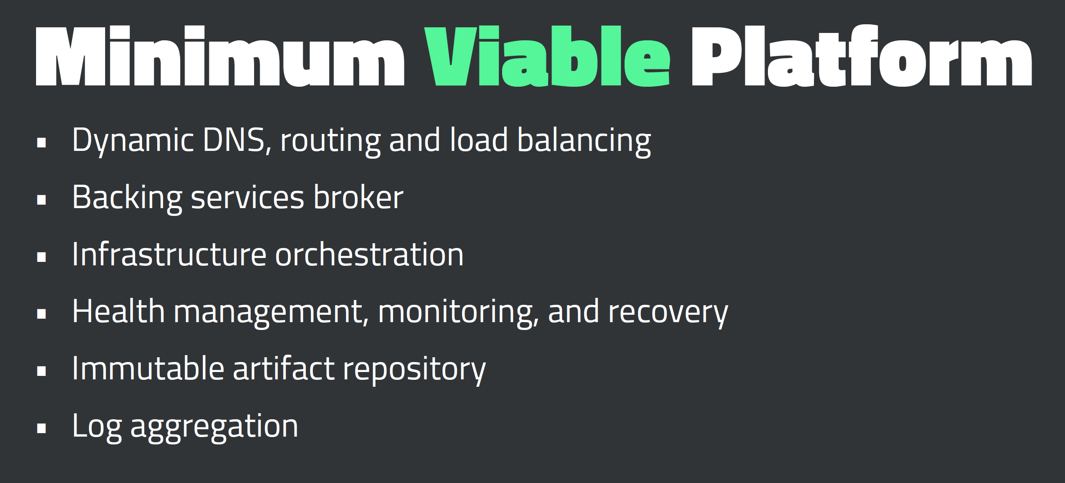

Slide 36
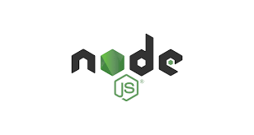


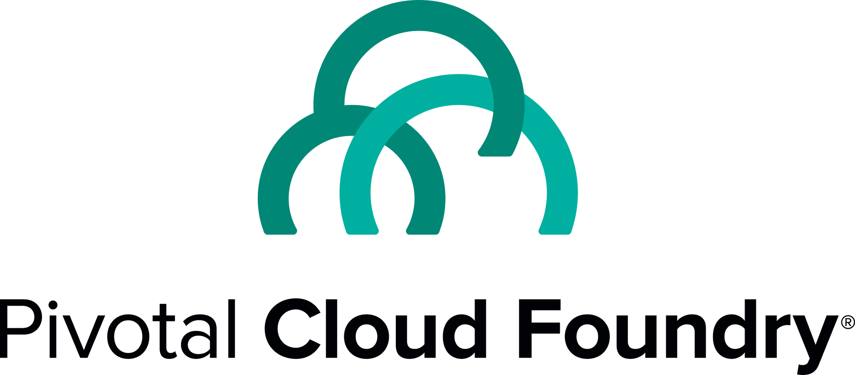
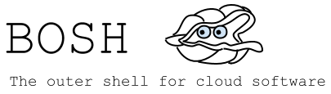
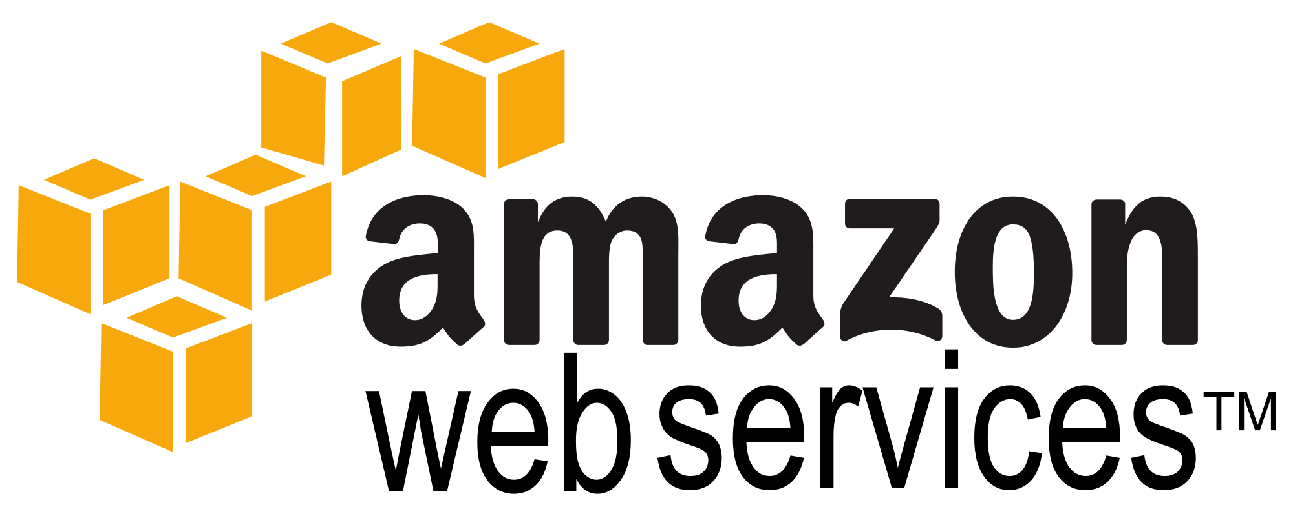
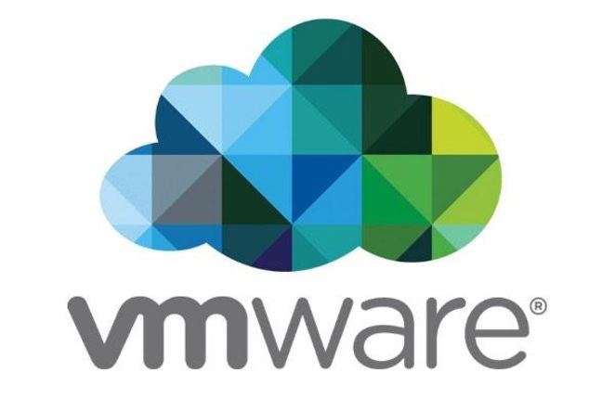

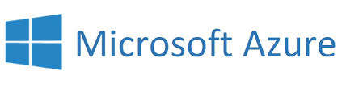
Culture
Cloud Native Framework
Tools
Application Framework
Spring Cloud
Spring Boot
Dev
Runtime Platform
Dev
IT Ops
Infrastructure Automation
BOSH.IO
IT Ops
Infrastructure
IT Ops
AWS
VMWare
OpenStack
Azure
Notes:
Pivotal breaks down cloud native technology into 3 layers, which is all supported, reinforced and optimized by cloud native culture and Tools. The Application Framework is what’s used to implement 12-Factor designs, that will work on cloud-native runtimes and infrastructure automation. Pivotal is the 1st and only vendor to integrate microservices from end-to-end: from the app dev stack, to the cloud platform, and the underlying infrastructure automation.
Let’s lets talk a little more about Developers

Slide 37
The developer dream haiku
Here is my source code,
Run it in the Cloud for me,
I do not care how
Notes:
An important and in-demand resource these days – Your developers. This is what they really want, but can be afraid to trust.

Slide 40
Q&A

